Slide 1


Prediction of WHO Data
Tanmay
Gautham
shiva
Mohanraj

Slide 2

Objective:
To find a suitable model for predicting life expectancy.
To narrow down significant predictors for estimating life expectancy.
To understand the correlation between variables.
To estimate the impact of dependant variables by predictors.
Sabareesh Karthick Senthilkumar
Snehith Reddy Boomi

Slide 3
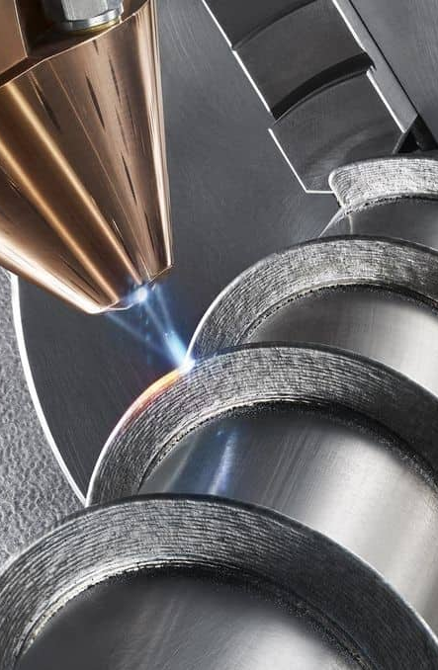

Top four countries with high Life expectancy.
Why life expectancy?
Countries | Years for males | Countries | Years for females
Switzerland | 81.3 | Japan | 86.8
Australia | 81.2 | Singapore | 86.1
Iceland | 80.9 | Spain | 85.5
Sweden | 80.7 | Korea | 85.5
Life expectancy is the average years of life remaining at a given age, if currently prevailing age-specific mortality rates continue throughout the lifespan.
Life expectancy is popularly used:
For monitoring trends in a nation or worldwide
It is a defining feature for labeling a nation, state, locality based upon their lifestyle, eating habits, alcohol consumption, crime rates and etc.
Least three countries Life expectancy data.
Countries | Years for males | Countries | Years for females
Lesotho | 51.7 | Chad | 54.5
Chad | 51.7 | Ivoire | 54.5
Central africa | 50.9 | Central africa | 54.1

Slide 4

Dataset Description: -
The constant independent variable is "life expectancy."
Alcohol, diseases, economic data, population, and forms of mortality will be used as predictors to determine the association with the dependent variable.
"Alcohol consumption rate" is a component of alcohol data. Hepatitis B, measles, polio, diphtheria, and HIV/AIDS are among the illnesses.
"Percentage expenditure," "Total expenditure," and "GDP" are some examples of economic data.
We will also make use of the "Population" statistics, which represents the population's overall size.
Data will be presented as "Adult mortality" and "Under 5 deaths" for death types. Each piece of information has been documented and is unique to its country.
The dimension of the dataset is 2938 x 22 entries

Slide 5
Dataset Description: -
DATA VARIABLE | DATA INFO | TYPE OF VARIABLE | RANGE | DISTRIBUTION TYPE
Countries | Country | Categorical Nominal Variable | 193 Unique Values | Categorical Distribution
Years | Year | Numeric discrete Variable | 2000 to 2015 | Discrete Uniform Distribution
Adult Mortality | Adult Mortality Rates of both sexes (probability of dying between 15 and 60 years per 1000 population) | Numeric Continuous variable | 1 - 723 | Poisson Distribution
Under 5 Deaths | Number of under-five deaths per 1000 population | Numeric discrete Variable | 0 - 2500 | Poisson Distribution
Alcohol Consumption | Alcohol, recorded per capita (15+) consumption (in litres of pure alcohol) | Numeric Continuous variable | 0.01 - 17.9 | Gamma Distribution

Slide 6

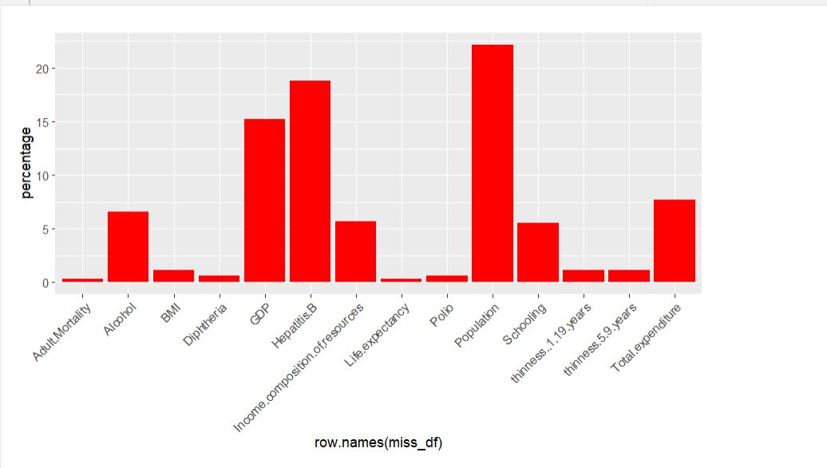

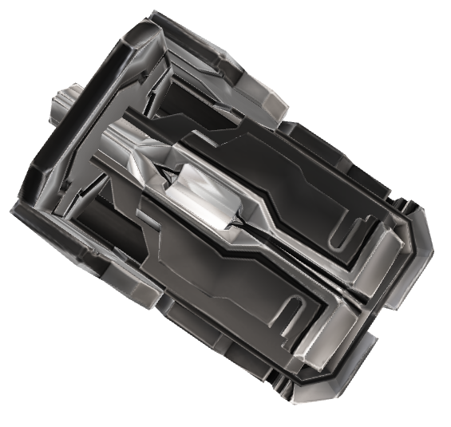
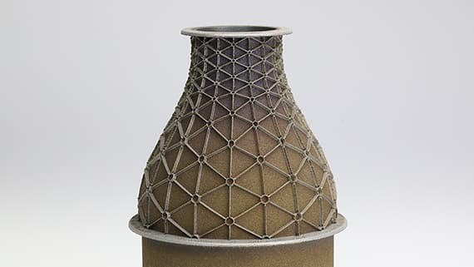
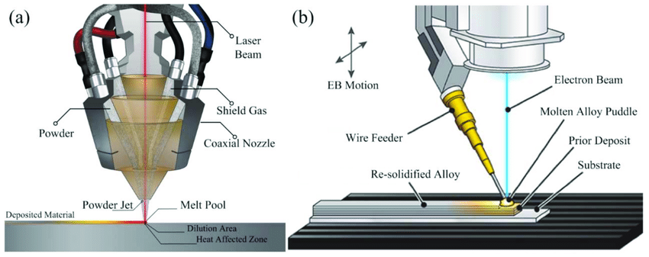
Missing values
Pre-Processing
From the imported dataset, the percentage of missing values in each column are plotted :
Filling the missing data using:
Mean Imputation
Median Imputation
Interpolation
Feature Handling
Model selection and Fitting the Model
and Finishing
Post-Processing
Materials
Ceramics and Polymers
Metals (either wire or powder)
Fe, Ti, Al
Inconel, Monel, Ti-6-4, Stainless Stell
Energy Source
Laser
Electron Beam
Plasma or Electric arc
Hybrid – Arc or Laser
https://www.johnhart.com.au/software/hypermill-software/hypermill-additive-manufacturing/directed-energy-deposition

Slide 7


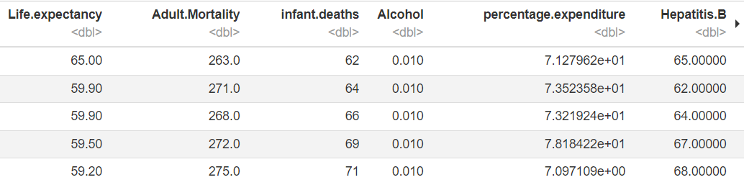
Interpolation
Why Interpolation ?
Why not Mean or Median ?
Interpolation works by using the values of the adjacent data points to estimate the missing value.
We have chosen interpolation, because it preserves the underlying patterns in the data, such as trends and seasonality.
Does not take into account any patterns or trends.
Mean imputations are highly sensitive to Outliers.
Median imputations results in
loss of information.
https://www.johnhart.com.au/software/hypermill-software/hypermill-additive-manufacturing/directed-energy-deposition
Notes:
why interpolation method ?
mean and median imputation do not take into account any patterns or trends in the data and can result in biased estimates of the true values.

Slide 8
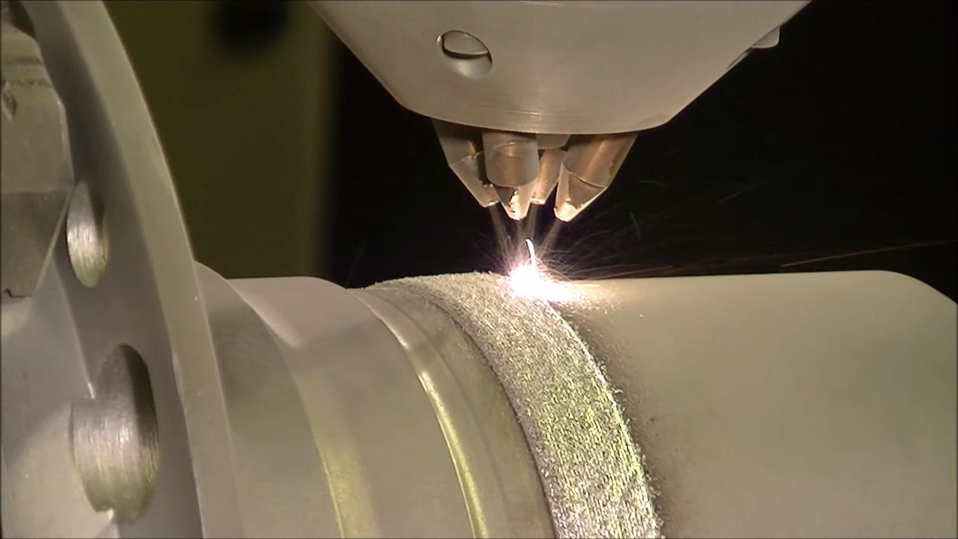
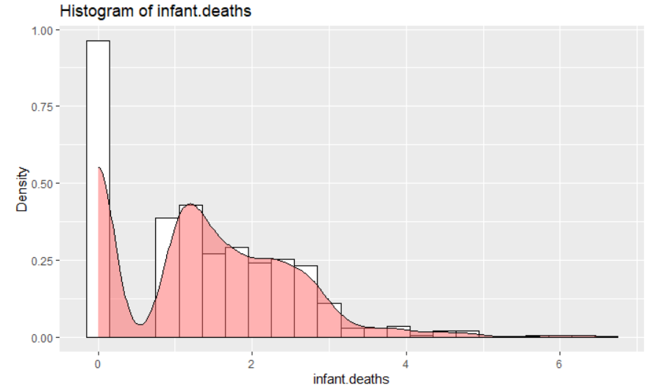
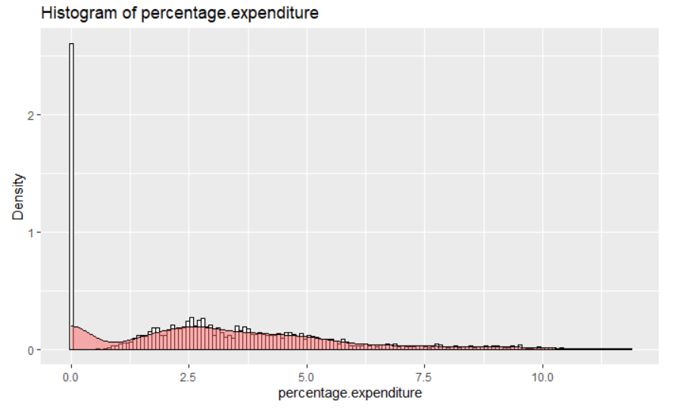
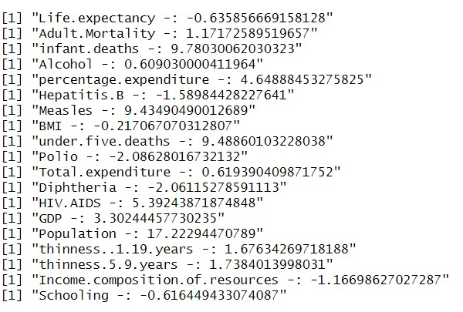
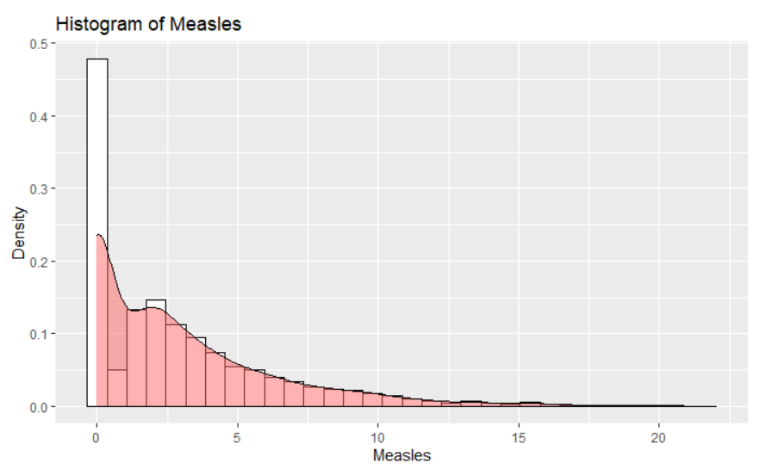
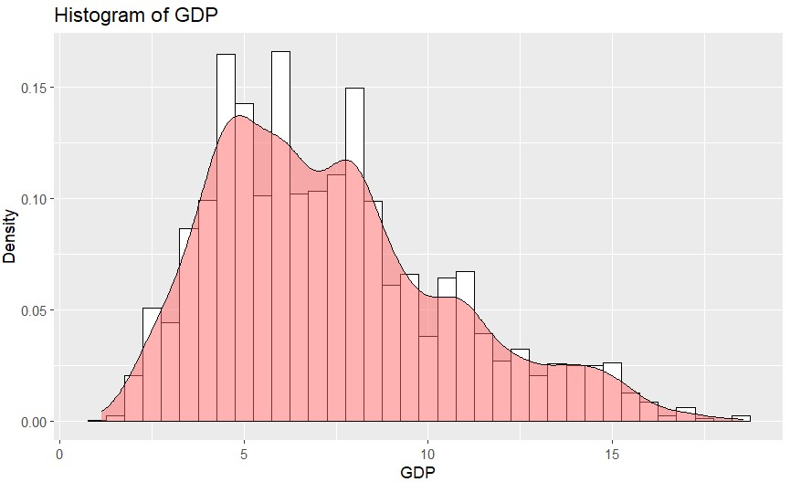
Nozzle Alignment
The position of the deposition head or nozzle must be carefully calibrated to ensure that it is aligned with the substrate. This may involve adjusting the height, angle, or orientation of the nozzle to achieve the desired deposition characteristics.
Laser or Electron Beam
The laser or electron beam is then activated, which melts the material and fuses it to the substrate. The deposition head is moved along the toolpath, depositing material layer by layer to build up the object.
Skewness and Normalization

Slide 9

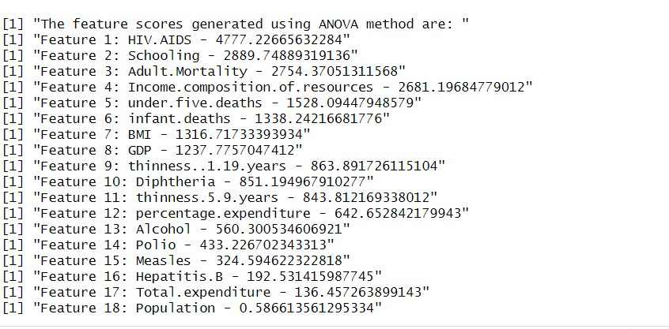
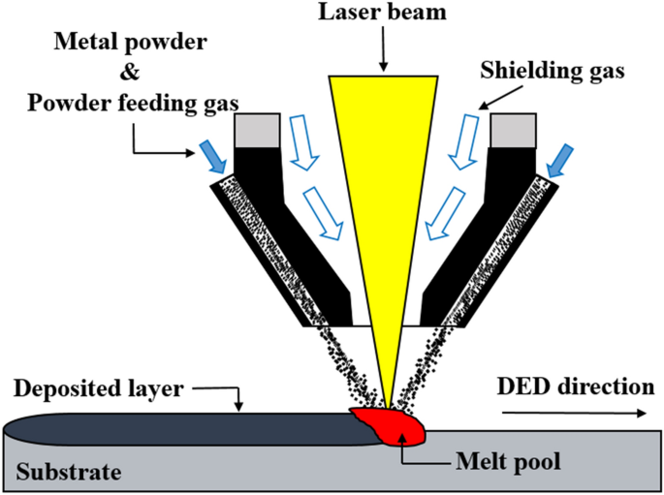
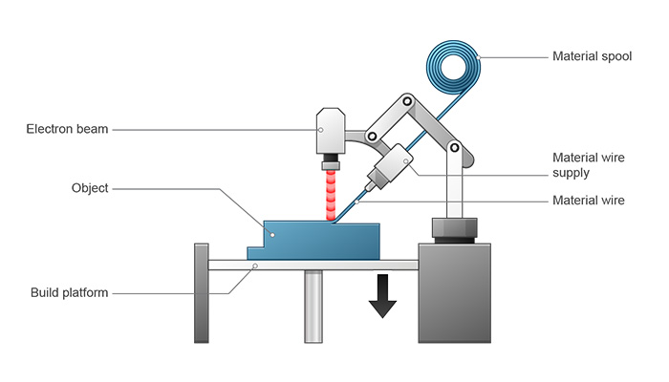
ANOVA method:
Pre processing
ANOVA is a familiar method for evaluating predictors and it is commonly used to filter out most significant variable in a dataset.
Feature handling
Feature handling in corporates:
ANOVA method
Correlation with Heatmap
Lasso Regression
Model selection and fitting the model
Post processing and conclusion
https://www.johnhart.com.au/software/hypermill-software/hypermill-additive-manufacturing/directed-energy-deposition

Slide 10

Nozzle Alignment
The position of the deposition head or nozzle must be carefully calibrated to ensure that it is aligned with the substrate. This may involve adjusting the height, angle, or orientation of the nozzle to achieve the desired deposition characteristics.
Laser or Electron Beam
The laser or electron beam is then activated, which melts the material and fuses it to the substrate. The deposition head is moved along the toolpath, depositing material layer by layer to build up the object.
Correlation with heatmap:
Does Life Expectancy have positive or negative relationship with drinking alcohol?
Should a country having a lower life expectancy value(<65) increase its healthcare expenditure in order to improve its average lifespan?
What is the impact of schooling on the lifespan of humans?
Why Correlation ??
From the correlation analysis it is possible to identify the highly correlated variables. This is also known as multicollinearity. This needs to be resolved or else problems such as:
Inflated errors
Misleading of regression
Gauging effect of one predictor on its dependent variable

Slide 11
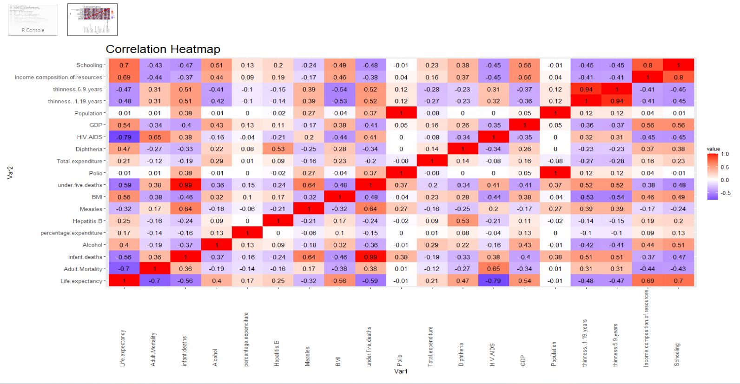

Slide 12
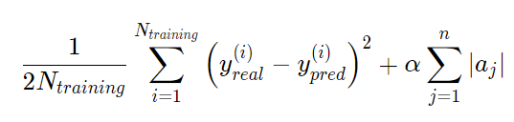
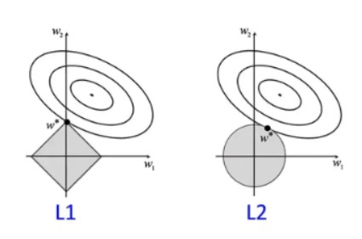
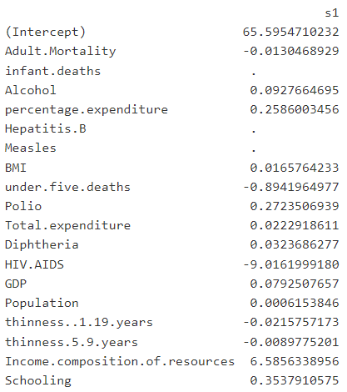
Nozzle Alignment
The position of the deposition head or nozzle must be carefully calibrated to ensure that it is aligned with the substrate. This may involve adjusting the height, angle, or orientation of the nozzle to achieve the desired deposition characteristics.
Laser or Electron Beam
The laser or electron beam is then activated, which melts the material and fuses it to the substrate. The deposition head is moved along the toolpath, depositing material layer by layer to build up the object.
Lasso Regression:
What is Regularization ??
Why Lasso ??
conclusion
Regularization solves the problem of Overfitting causes low model accuracy. It happens when the model learns the data as well as the noises in the training set.
So based upon this, a lasso model is being developed and the corresponding coefficients / feature scores are extracted from that to determine variables which could be eliminated further. LASSO involves a penalty factor that determines how many features are retained; using cross-validation to choose the penalty factor

Slide 13

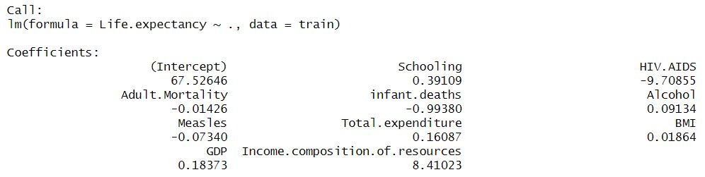
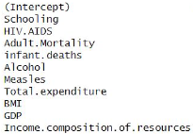
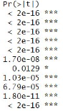
Nozzle Alignment
The position of the deposition head or nozzle must be carefully calibrated to ensure that it is aligned with the substrate. This may involve adjusting the height, angle, or orientation of the nozzle to achieve the desired deposition characteristics.
Laser or Electron Beam
The laser or electron beam is then activated, which melts the material and fuses it to the substrate. The deposition head is moved along the toolpath, depositing material layer by layer to build up the object.
Multiple Regression:
Pre processing
Feature Handling
Model selection and fitting the model
Using the above model for Multiple regression with ten predictors and their coefficients.
Residual standard error | 3.79
Multiple R-squared | 0.8385
P-value | < 2.2e-16
Adjusted R squared value | 0.8
Multiple regression
Polynomial regression
Post processing and conclusion

Slide 14

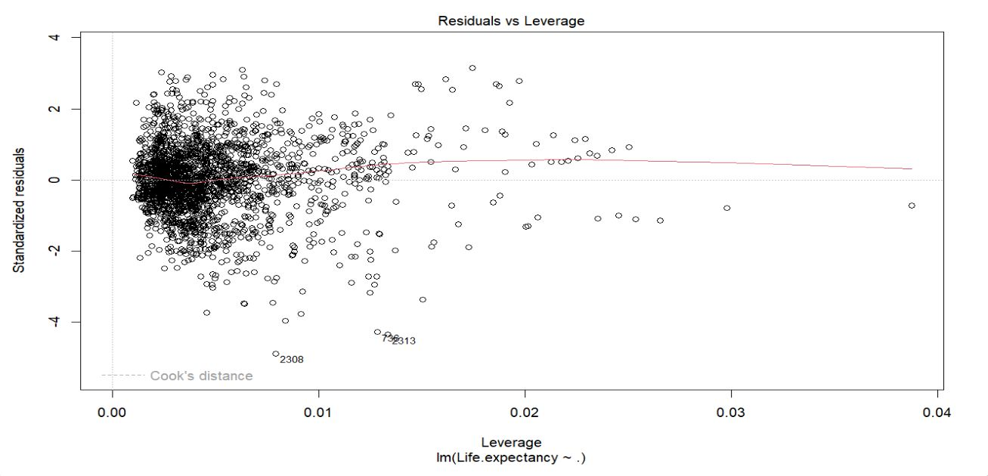
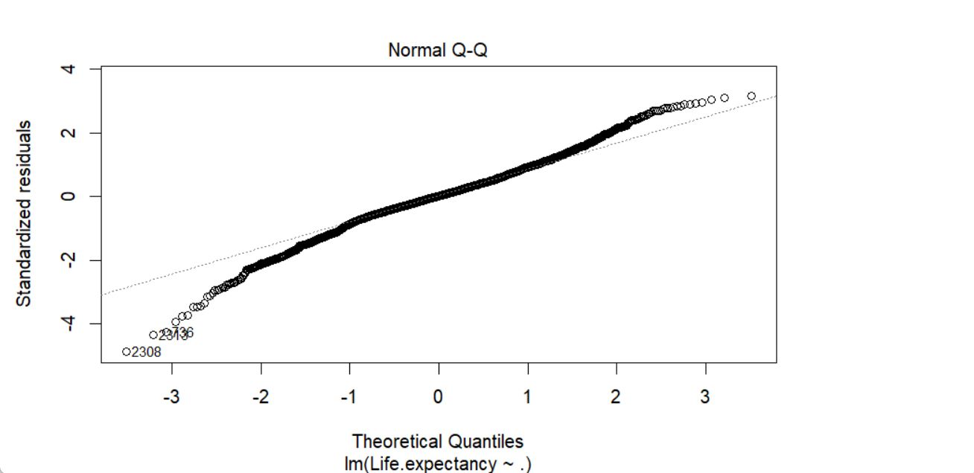
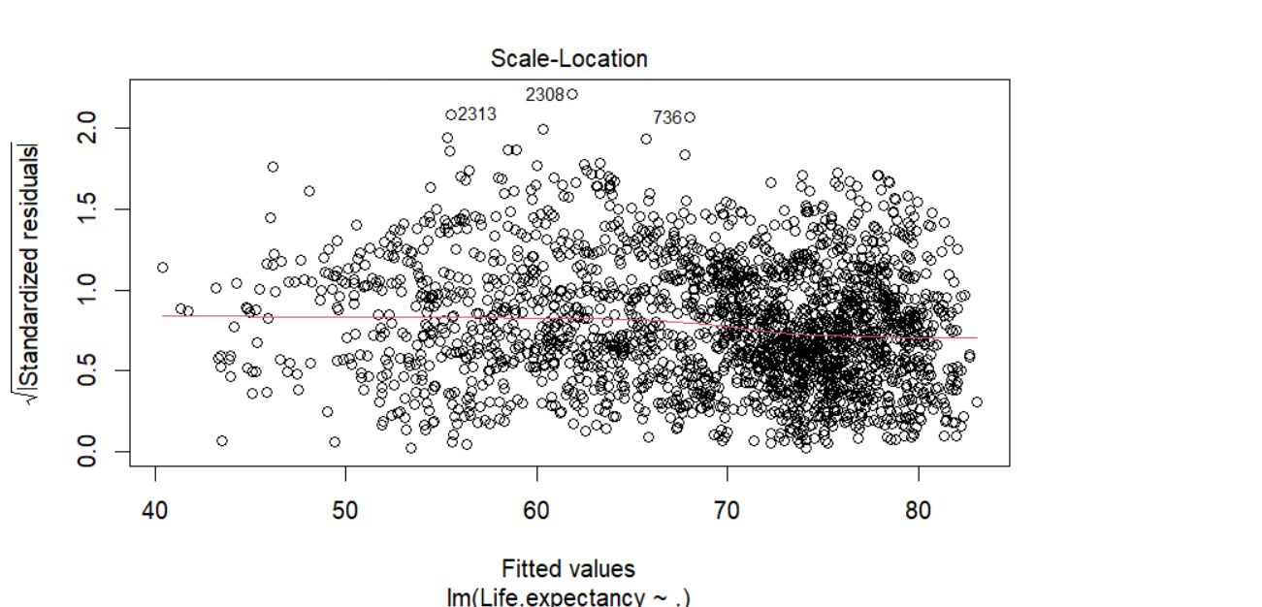
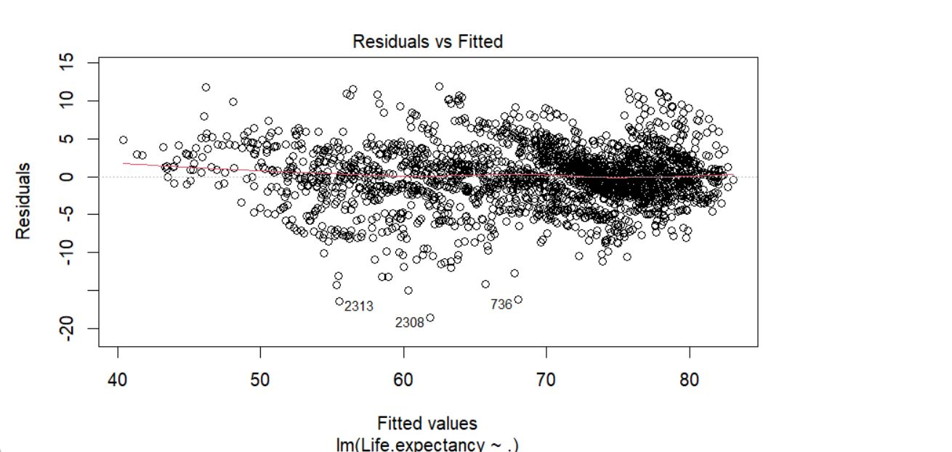
Nozzle Alignment
The position of the deposition head or nozzle must be carefully calibrated to ensure that it is aligned with the substrate. This may involve adjusting the height, angle, or orientation of the nozzle to achieve the desired deposition characteristics.
Laser or Electron Beam
The laser or electron beam is then activated, which melts the material and fuses it to the substrate. The deposition head is moved along the toolpath, depositing material layer by layer to build up the object.
Multiple regression plots

Slide 15

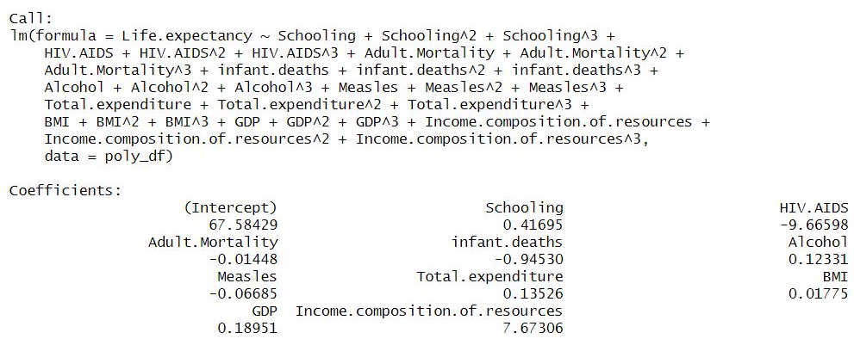
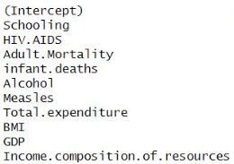
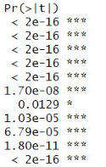
Poly Regression:
Residual standard error | 3.809
Multiple R-squared | 0.8401
P-value | < 2.2e-16
Adjusted R squared value | 0.8396
Using the above cubic polynomial model with ten predictors and their coefficients.
Since all the coefficients are significant which we can see from the R summary output as the P-value for the coefficients are lower than the 95 % confidence interval.
So from the coefficients we can interpret that Income composition and schooling majorly affects the life expectancy.
HIV has negative highest coefficient value , we can conclude its a biased data.

Slide 16

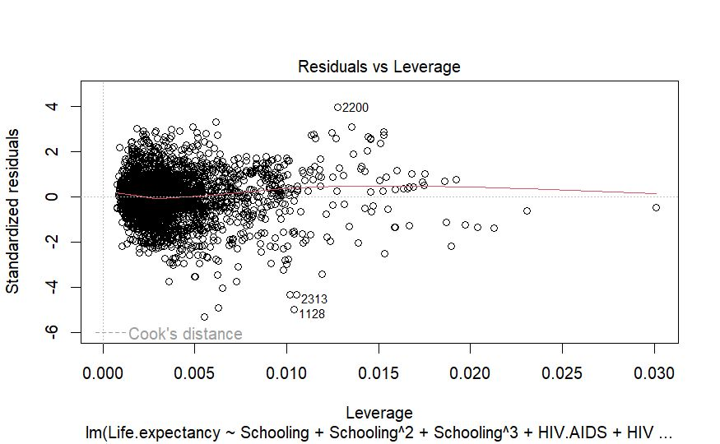
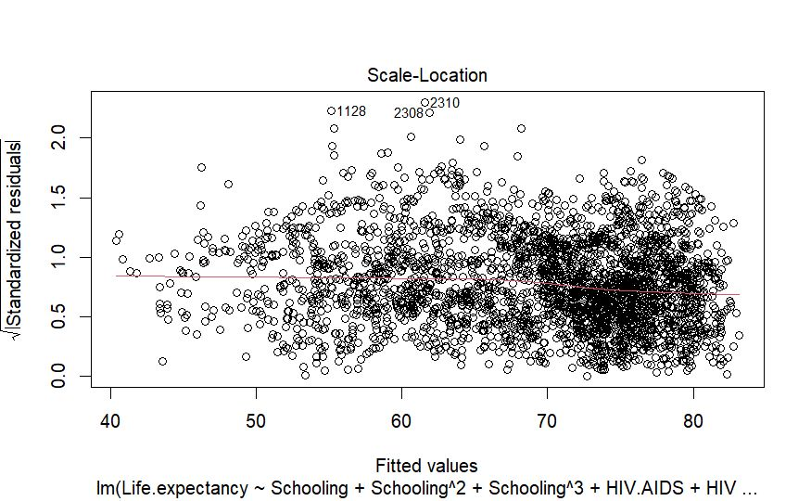
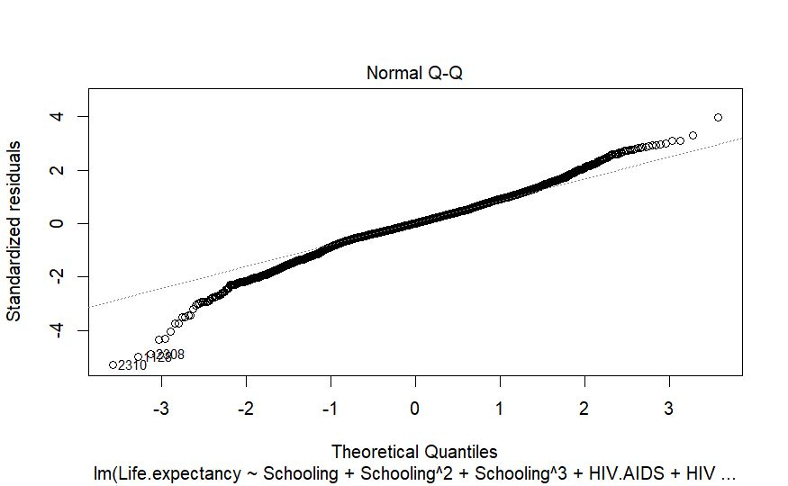
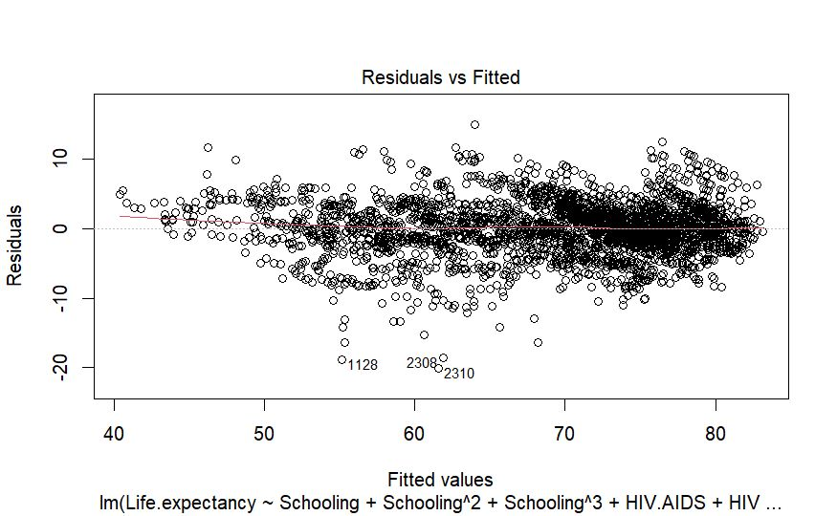
Nozzle Alignment
The position of the deposition head or nozzle must be carefully calibrated to ensure that it is aligned with the substrate. This may involve adjusting the height, angle, or orientation of the nozzle to achieve the desired deposition characteristics.
Laser or Electron Beam
The laser or electron beam is then activated, which melts the material and fuses it to the substrate. The deposition head is moved along the toolpath, depositing material layer by layer to build up the object.
Poly regression plots

Slide 17

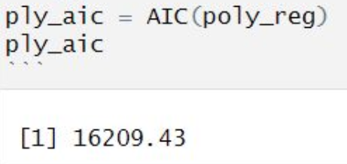
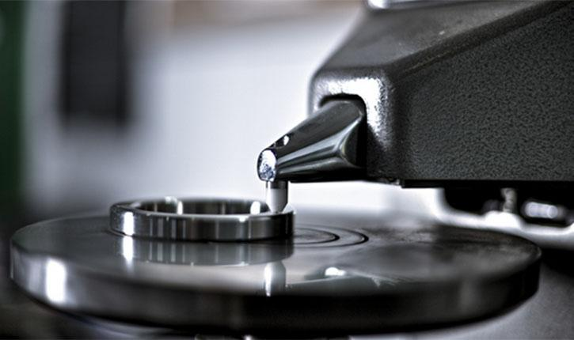
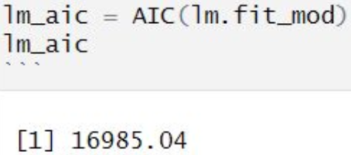
Pre processing
AIC (Akaike Information Criterion):
Feature Handling
It is a relative quality of statistical model used in selection of model based on the AIC scores, lowest score is considered to as better model.
Model selection and fitting the model
From the code, we can infer the AIC scores for both polynomial and multiple regression.
Post processing
In Post processing we will validate models using:
AIC
polynomial AIC score = 16209.43
multiple regression AIC = 16985.04
Conclusion
https://www.johnhart.com.au/software/hypermill-software/hypermill-additive-manufacturing/directed-energy-deposition

Slide 18
Conclusion:
We have successfully managed to remove all the less significant columns, which can be seen from the P-val of the summary since all the p-values are less then the 95 % confidence interval.
Both multiple and polynomial regression model is fitted with significant variable.
From the Residual vs Fitted graph for the polynomial model we can see that the variables are dense in the ending and line is a good fit.
AIC scores have been determined for both the models and we can conclude that polynomial has lower AIC scores , so Polynomial model can be used for prediction.
hiv is sample bias or insignificant or biased result.
https://www.johnhart.com.au/software/hypermill-software/hypermill-additive-manufacturing/directed-energy-deposition

Slide 19

https://ars.els-cdn.com/content/image/1-s2.0-S0030399221004254-gr1_lrg.jpg
https://www.sciencedirect.com/science/article/pii/S1369702121001139#s0055
https://www.slideshare.net/ShashankAmin1/metal-directed-energy-deposition-am-technolgies
https://www.sciencedirect.com/science/article/pii/S0030399221004254
https://www.researchgate.net/figure/AM-defects-a-keyhole-induced-porosity-b-cracks-and-c-delamination-16_fig3_334041292
https://www.additivemanufacturing.media/articles/directed-energy-deposition-ded-error-turns-nozzle-into-chess-piece-am-why-the-failure-episode-3
https://www.sciencedirect.com/science/article/pii/S2351978921001189
https://www.johnhart.com.au/software/hypermill-software/hypermill-additive-manufacturing/directed-energy-deposition
QUESTIONS?
https://www.johnhart.com.au/software/hypermill-software/hypermill-additive-manufacturing/directed-energy-deposition

Slide 20
Thank you

